Slide 1


+
Power BI + Microsoft CRM 2015 on premise integration using data gateway

Slide 2
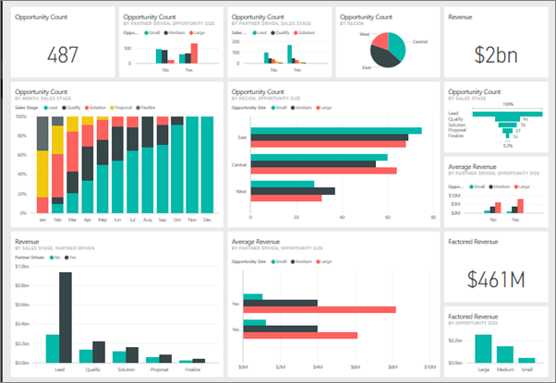
Power BI – quick overview
Create interactive reports and dashboards
Data modelling and analytics
Connect to data sources
Desktop and cloud service
Power BI Service is the cloud version.
Great for sharing with others

Slide 3
MS CRM 2015 – quick overview

Slide 4
Data Gateway – quick overview

Slide 5
The Integration
Power BI is not natively supported in CRM 2015 on premise version. Hence the solution below
Diagram
GRDC Setup
Issues

Slide 6
Questions?
Bring on data gateway questions. I think I got them covered!

